Slide 1


ROBO Clash

Slide 2

Process Flow
Notification
Registration
Round - 1
Round -2
Round - 3
Winner Identification

Slide 3


Round - 1
Leads to the Manual and the code

Slide 4

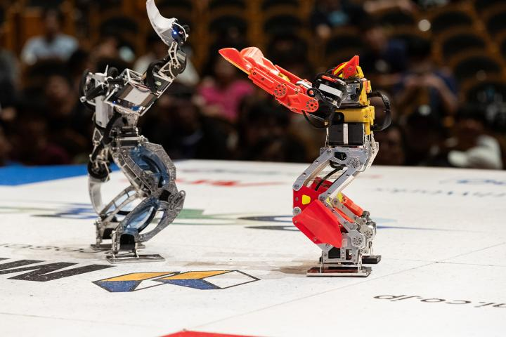
Round - 2
Battle Arena
Each round moves you up the round through points board and knock outs.

Slide 5
Round - 3
The Final Showdown
The best 02 compete against each other & finalists battle against each other and Winner is declared.

Slide 6
Costing
Materials | No of items | Per cost | Total
Robots | 15 | ₹10000 | ₹150,000
Elephant toothpaste project | ₹10000
Total Cost |  |  | ₹160,000

